Slide 1
Transactions
Transaction Concept
Transaction States
Concurrent Executions
Serializability
Recoverability
Implementation of Isolation
Transaction Definition in SQL
Testing for Serializability.

Slide 2
Transaction Concept
A transaction is a unit of program execution that accesses and possibly updates various data items.
E.g. transaction to transfer $50 from account A to account B:
  read(A)
  2. A := A – 50
  3. write(A)
  4. read(B)
  5. B := B + 50
  6. write(B)
Two main issues to deal with:
  Failures of various kinds, such as hardware failures and system crashes
  Concurrent execution of multiple transactions

Slide 3
Read(x): Which transfers the data item X from the database to a variable X present in a buffer in main memory belonging to the transaction that executed read operation.
Write(x): Which transfers the value in the variable X in the main memory buffer of the transaction that executed the write to the data item X in the database.

Slide 4
Example of Fund Transfer
Transaction to transfer $50 from account A to account B:
  1. read(A)
  2. A := A – 50
  3. write(A)
  4. read(B)
  5. B := B + 50
  6. write(B)
Atomicity requirement
  if the transaction fails after step 3 and before step 6, money will be “lost” leading to an inconsistent database state
    Failure could be due to software or hardware
  the system should ensure that updates of a partially executed transaction are not reflected in the database
Durability requirement — once the user has been notified that the transaction has completed (i.e., the transfer of the $50 has taken place), the updates to the database by the transaction must persist even if there are software or hardware failures.

Slide 5
Example of Fund Transfer (Cont.)
Transaction to transfer $50 from account A to account B:
  1. read(A)
  2. A := A – 50
  3. write(A)
  4. read(B)
  5. B := B + 50
  6. write(B)
Consistency requirement in above example:
  the sum of A and B is unchanged by the execution of the transaction
In general, consistency requirements include
    Explicitly specified integrity constraints such as primary keys and foreign keys
    Implicit integrity constraints
      e.g. sum of balances of all accounts, minus sum of loan amounts must equal value of cash-in-hand
  A transaction must see a consistent database.
  During transaction execution the database may be temporarily inconsistent.
  When the transaction completes successfully the database must be consistent
    Erroneous transaction logic can lead to inconsistency

Slide 6
Example of Fund Transfer (Cont.)
Isolation requirement — if between steps 3 and 6, another transaction T2 is allowed to access the partially updated database, it will see an inconsistent database (the sum A + B will be less than it should be).
T1 T2
  1. read(A)
  2. A := A – 50
  3. write(A)
  read(A), read(B), print(A+B)
  4. read(B)
  5. B := B + 50
  6. write(B
Isolation can be ensured trivially by running transactions serially
  that is, one after the other.
However, executing multiple transactions concurrently has significant benefits, as we will see later.

Slide 7
ACID Properties
A transaction is a unit of program execution that accesses and possibly updates various data items. To preserve the integrity of data the database system must ensure:
Atomicity. Either all operations of the transaction are properly reflected in the database or none are.
Consistency. Execution of a transaction in isolation preserves the consistency of the database.
Isolation. Although multiple transactions may execute concurrently, each transaction must be unaware of other concurrently executing transactions. Intermediate transaction results must be hidden from other concurrently executed transactions.
  That is, for every pair of transactions T_{i} and T_{j}, it appears to T_{i} that either T_{j}, finished execution before T_{i} started, or T_{j} started execution after T_{i} finished.
Durability. After a transaction completes successfully, the changes it has made to the database persist, even if there are system failures.

Slide 8
Transaction States
Active – the initial state; the transaction stays in this state while it is executing
Partially committed – after the final statement has been executed.
Failed -- after the discovery that normal execution can no longer proceed.
Aborted – after the transaction has been rolled back and the database restored to its state prior to the start of the transaction. Two options after it has been aborted:
  restart the transaction
    can be done only if no internal logical error
  kill the transaction
Committed – after successful completion.

Slide 9

Transaction State Diagram

Slide 10

Implementation of Atomicity and Durability
The recovery-management component of a database
system implements the support for atomicity and durability.
E.g. the shadow-database scheme:
  all updates are made on a shadow copy of the database
    db_pointer is made to point to the updated shadow copy after
      the transaction reaches partial commit and
      all updated pages have been flushed to disk.

Slide 11
Implementation of Atomicity and Durability (Cont.)
db_pointer always points to the current consistent copy of the database.
  In case transaction fails, old consistent copy pointed to by db_pointer can be used, and the shadow copy can be deleted.
The shadow-database scheme:
  Assumes that only one transaction is active at a time.
  Assumes disks do not fail
  Useful for text editors, but
    extremely inefficient for large databases
    Variant called shadow paging reduces copying of data, but is still not practical for large databases
  Does not handle concurrent transactions

Slide 12
Concurrent Executions
Multiple transactions are allowed to run concurrently in the system. Advantages are:
  increased processor and disk utilization, leading to better transaction throughput
    E.g. one transaction can be using the CPU while another is reading from or writing to the disk
  reduced average response time for transactions: short transactions need not wait behind long ones.
Concurrency control schemes – mechanisms to achieve isolation
  that is, to control the interaction among the concurrent transactions in order to prevent them from destroying the consistency of the database

Slide 13
Introduction to Transaction Processing (6)
Why Concurrency Control is needed:
The Lost Update Problem
  This occurs when two transactions that access the same database items have their operations interleaved in a way that makes the value of some database item incorrect.
The Temporary Update (or Dirty Read) Problem
  This occurs when one transaction updates a database item and then the transaction fails for some reason (see Section 17.1.4).
  The updated item is accessed by another transaction before it is changed back to its original value.
The Incorrect Summary Problem
  If one transaction is calculating an aggregate summary function on a number of records while other transactions are updating some of these records, the aggregate function may calculate some values before they are updated and others after they are updated.
Slide 17- <number>

Slide 14
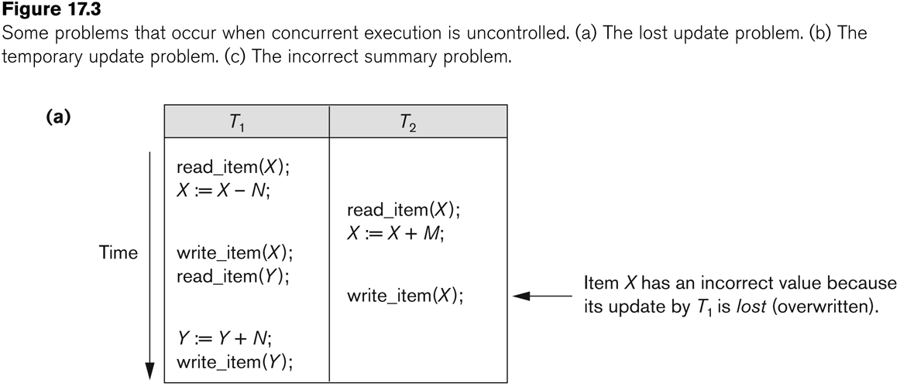
Concurrent execution is uncontrolled: (a) The lost update problem.
Slide 17- <number>

Slide 15
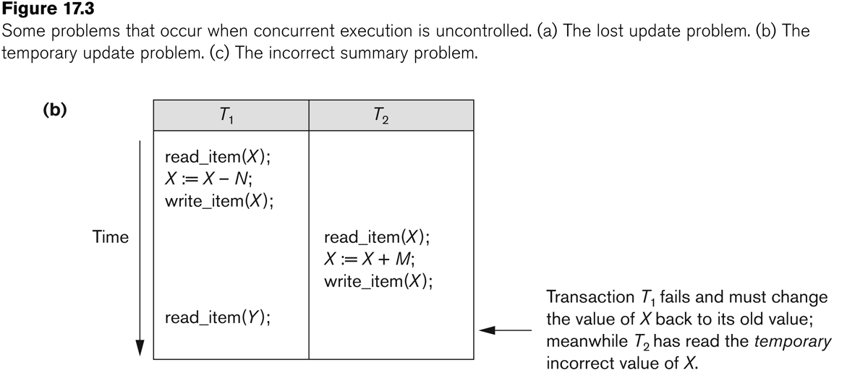
Concurrent execution is uncontrolled: (b) The temporary update problem.
Slide 17- <number>

Slide 16
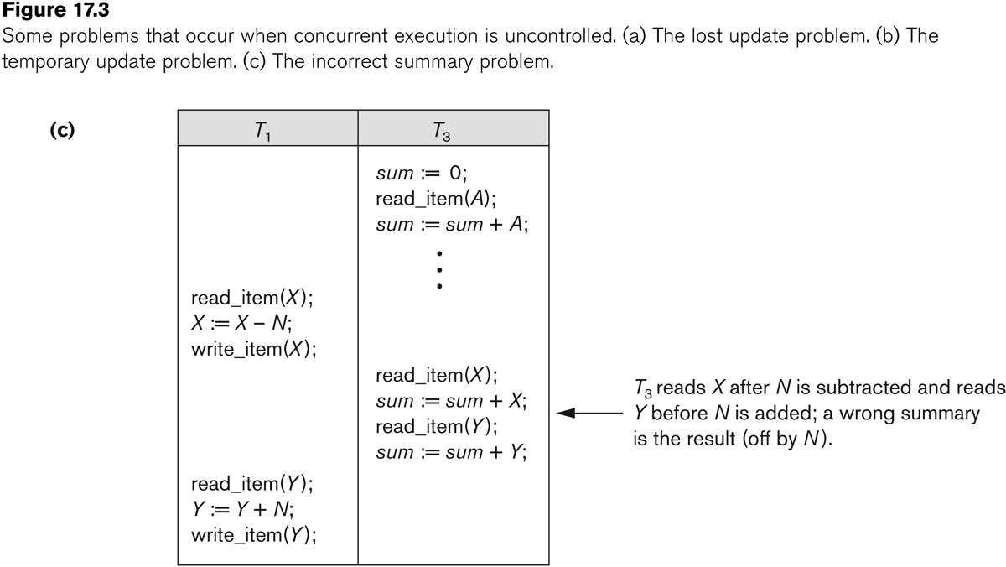
Concurrent execution is uncontrolled: (c) The incorrect summary problem.
Slide 17- <number>

Slide 17
Transaction and System Concepts
Recovery manager keeps track of the following operations:
  begin_transaction: This marks the beginning of transaction execution.
  read or write: These specify read or write operations on the database items that are executed as part of a transaction.
  end_transaction: This specifies that read and write transaction operations have ended and marks the end limit of transaction execution.
    At this point it may be necessary to check whether the changes introduced by the transaction can be permanently applied to the database or whether the transaction has to be aborted because it violates concurrency control or for some other reason.
Slide 17- <number>

Slide 18
Transaction and System Concepts (3)
Recovery manager keeps track of the following operations (cont):
  commit_transaction: This signals a successful end of the transaction so that any changes (updates) executed by the transaction can be safely committed to the database and will not be undone.
  rollback (or abort): This signals that the transaction has ended unsuccessfully, so that any changes or effects that the transaction may have applied to the database must be undone.
Slide 17- <number>

Slide 19
Transaction and System Concepts
Recovery techniques use the following operators:
  undo: Similar to rollback except that it applies to a single operation rather than to a whole transaction.
  redo: This specifies that certain transaction operations must be redone to ensure that all the operations of a committed transaction have been applied successfully to the database.
Slide 17- <number>

Slide 20
Schedules
Schedule – a sequences of instructions that specify the chronological order in which instructions of concurrent transactions are executed
  a schedule for a set of transactions must consist of all instructions of those transactions
  must preserve the order in which the instructions appear in each individual transaction.
A transaction that successfully completes its execution will have a commit instructions as the last statement
  by default transaction assumed to execute commit instruction as its last step
A transaction that fails to successfully complete its execution will have an abort instruction as the last statement

Slide 21



Schedule 2
Schedule 1

Slide 22
Schedule – a sequences of instructions that specify the chronological order in which instructions of concurrent transactions are executed
Serial Schedule : instructions belonging to the one transaction appears together in schedule.

Slide 24
Concurrent Schedule : instructions from transaction will be interleaved.
In the case of multi users database system, more than one user are supposed to use the database at the same time, hence the database has to be in a consistent state. Hence, multi programming systems are used, which executes the processes concurrently by inter leaving them.

Slide 25
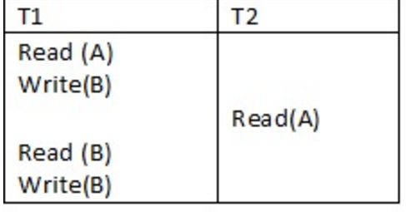

Slide 26
Advantages of Concurrent execution :
  Improved throughput
  Reduced Waiting Times
  Better Resource Utilization
Disadvantages :
  May lead to incorrectness
  Inconsistency of data is possible

Slide 27

Schedule 1
Let T₁ transfer $50 from A to B, and T₂ transfer 10% of the balance from A to B.
A serial schedule in which T₁ is followed by T₂ :

Slide 28

Schedule 2
A serial schedule where T₂ is followed by T₁

Slide 29

Schedule 3
Let T₁ and T₂ be the transactions defined previously. The following schedule is not a serial schedule, but it is equivalent to Schedule 1.
In Schedules 1, 2 and 3, the sum A + B is preserved.

Slide 30

Schedule 4
The following concurrent schedule does not preserve the value of (A + B ).

Slide 31
Serializability
Basic Assumption – Each transaction preserves database consistency.
Thus serial execution of a set of transactions preserves database consistency.
A (possibly concurrent) schedule is serializable if it is equivalent to a serial schedule.
  Types of Serialiazability:
  1. conflict serializability
  2. view serializability
Simplified view of transactions
  We ignore operations other than read and write instructions
  We assume that transactions may perform arbitrary computations on data in local buffers in between reads and writes.
  Our simplified schedules consist of only read and write instructions.

Slide 32
Conflicting Instructions
Instructions l_{i} and l_{j} of transactions T_{i} and T_{j} respectively, conflict if and only if there exists some item Q accessed by both l_{i} and l_{j}, and at least one of these instructions wrote Q.
1. l_{i} = read(Q), l_{j} = read(Q). l_{i} and l_{j} don’t conflict.
2. l_{i} = read(Q), l_{j} = write(Q). They conflict.
3. l_{i} = write(Q), l_{j} = read(Q). They conflict
4. l_{i} = write(Q), l_{j} = write(Q). They conflict
Intuitively, a conflict between l_{i} and l_{j} forces a (logical) temporal order between them.
  If l_{i} and l_{j} are consecutive in a schedule and they do not conflict, their results would remain the same even if they had been interchanged in the schedule.

Slide 33
Conflict Serializability
A (possibly concurrent) schedule is serializable if it is equivalent to a serial schedule.
If a schedule S can be transformed into a schedule S´ by a series of swaps of non-conflicting instructions, we say that S and S´ are conflict equivalent.
We say that a schedule S is conflict serializable if it is conflict equivalent to a serial schedule

Slide 34
Conflict Serializability (Cont.)
Schedule 3 can be transformed into Schedule 6, a serial schedule where T₂ follows T₁, by series of swaps of non-conflicting instructions.
  Therefore Schedule 3 is conflict serializable.
Schedule 3
Schedule 6

Slide 35

Conflict Serializability (Cont.)
Example of a schedule that is not conflict serializable:
We are unable to swap instructions in the above schedule to obtain either the serial schedule < T₃, T₄ >, or the serial schedule < T₄, T₃ >.

Slide 36
Examples:
Transaction 1 Begin Transation
UPDATE accounts SET balance = balance - 100 WHERE acct_id = 31414 end
Transaction 2:
Begin transaction
UPDATE accounts SET balance = balance - 100
WHERE acct_id = 31414
UPDATE accounts SET balance = balance + 100
WHERE acct_id = 31415
end
Transaction 1: | r₁(A), w₁(A)
Transaction 2: | r₂(A), w₂(A), r₂(B), w₂(B)

Slide 37
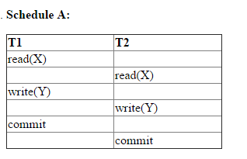
Example:
S1: R₁(A), W₁(A), R₂(A), W₂(A), R₁(B), W₁(B), R₂(B), W₂(B)
Check given schedule is Conflict Serializable.
S2: R₁(A), W₁(A), R₁(B), W₂(A), R₂(A), W₁(B), R₂(B), W₂(B)

Slide 39
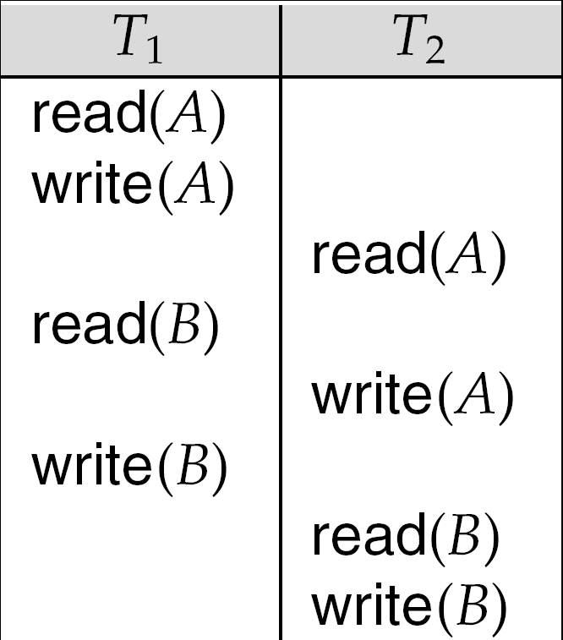

Slide 40



Slide 41
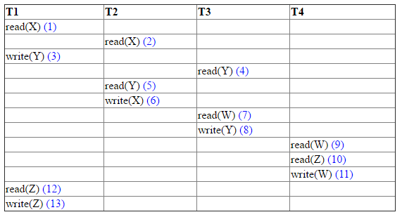
Serializability Testing:
Example 1:

Slide 42

Testing for Serializability
Consider some schedule of a set of transactions T₁, T₂, ..., T_{n}
Precedence graph — a direct graph where the vertices are the transactions (names).
We draw an arc from T_{i} to T_{j} if the two transaction conflict, and T_{i} accessed the data item on which the conflict arose earlier.
We may label the arc by the item that was accessed.
Example 1
x
y

Slide 43
Precedence graph — a direct graph where the vertices are the transactions (names).
The set of edges consisting of all edges from Ti->Tj for which one of the three condition holds:
  Ti executes write(Q) before Tj executes read(Q)
  Ti executes read(Q) before Tj executes write(Q)
  Ti executes write(Q) before Tj executes write(Q)

Slide 44

Test for Conflict Serializability
A schedule is conflict serializable if and only if its precedence graph is acyclic.
Cycle-detection algorithms exist which take order n² time, where n is the number of vertices in the graph.
  (Better algorithms take order n + e where e is the number of edges.)
If precedence graph is acyclic, the serializability order can be obtained by a topological sorting of the graph.

Slide 45
Example Schedule (Schedule A) + Precedence Graph
T₁ T₂ T₃ T₄ T₅
read(X)
read(Y)
read(Z)
read(V)
read(W)
read(W)
read(Y)
write(Y)
write(Z)
read(U)
read(Y)
write(Y)
read(Z)
write(Z)
read(U)
write(U)
T₁
T₂
T₄
T₃
T₅

Slide 46
Serializability Testing:
Example 1:

Slide 47
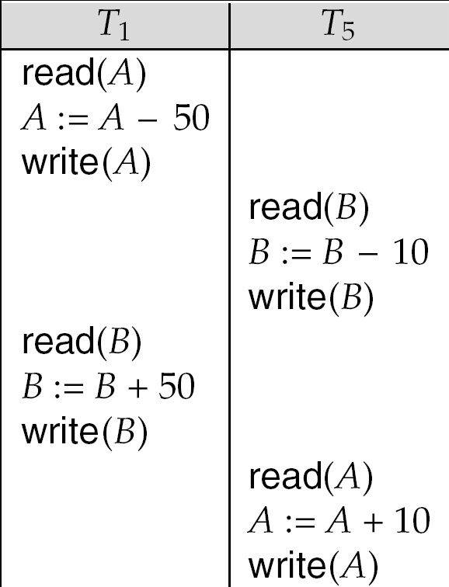
Serializability
The schedule below produces same outcome as the serial schedule < T₁, T₅ >, yet is not conflict equivalent or view equivalent to it.
Determining such equivalence requires analysis of operations other than read and write.

Slide 48
Testing for Serializability
Consider some schedule of a set of transactions T₁, T₂, ..., T_{n}
Precedence graph — a direct graph where the vertices are the transactions (names).
We draw an arc from T_{i} to T_{j} if the two transaction conflict, and T_{i} accessed the data item on which the conflict arose earlier.
We may label the arc by the item that was accessed.
Example 1
x
y

Slide 49
Precedence graph — a direct graph where the vertices are the transactions (names).
The set of edges consisting of all edges from Ti->Tj for which one of the three condition holds:
  Ti executes write(Q) before Tj executes read(Q)
  Ti executes read(Q) before Tj executes write(Q)
  Ti executes write(Q) before Tj executes write(Q)

Slide 50
Test for Conflict Serializability
A schedule is conflict serializable if and only if its precedence graph is acyclic.
Cycle-detection algorithms exist which take order n² time, where n is the number of vertices in the graph.
  (Better algorithms take order n + e where e is the number of edges.)
If precedence graph is acyclic, the serializability order can be obtained by a topological sorting of the graph.

Slide 51
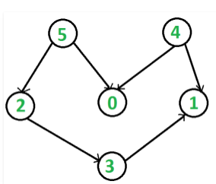
Topological sorting for Directed Acyclic Graph (DAG) is a linear ordering of vertices such that for every directed edge uv, vertex u comes before v in the ordering.
Following is a Topological Sort of the given graph 5 4 2 3 1 0

Slide 52
Algorithm For Topological Sorting Sequence
1. Choose a vertex in a graph without any predecessors.
In other words, it is a vertex with Zero In degree.
Delete this vertex and all the outgoing edges from it.
Repeat the above process till all the vertices are not deleted from the DAG

Slide 53
Example Schedule (Schedule A) + Precedence Graph
T₁ T₂ T₃ T₄ T₅
read(X)
read(Y)
read(Z)
read(V)
read(W)
read(W)
read(Y)
write(Y)
write(Z)
read(U)
read(Y)
write(Y)
read(Z)
write(Z)
read(U)
write(U)
T₁
T₂
T₄
T₃
T₅

Slide 54
  This is a linear order consistent with the partial order of the graph.
  For example, a serializability order for Schedule A would be
  T₅ → T₁ → T₃ → T₂ → T₄
    Are there others?

Slide 55
View Serializability
Let S and S´ be two schedules with the same set of transactions. S and S´ are view equivalent if the following three conditions are met, for each data item Q,
  If in schedule S, transaction T_{i} reads the initial value of Q, then in schedule S’ also transaction T_{i} must read the initial value of Q.
  If in schedule S transaction T_{i} executes read(Q), and that value was produced by transaction T_{j} (if any), then in schedule S’ also transaction T_{i} must read the value of Q that was produced by the same write(Q) operation of transaction T_{j} .
  The transaction (if any) that performs the final write(Q) operation in schedule S must also perform the final write(Q) operation in schedule S’.
As can be seen, view equivalence is also based purely on reads and writes
alone.

Slide 56

View Serializability (Cont.)
A schedule S is view serializable if it is view equivalent to a serial schedule.
Every conflict serializable schedule is also view serializable.
Below is a schedule which is view-serializable but not conflict serializable.
What serial schedule is above equivalent to?
Every view serializable schedule that is not conflict serializable has blind writes.

Slide 57
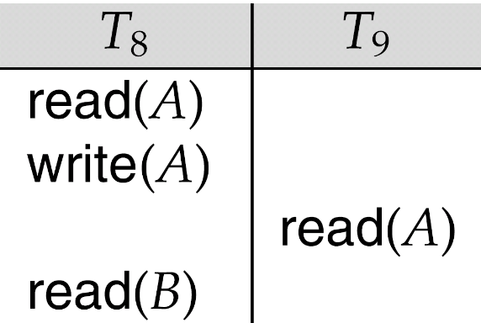
Recoverable Schedules
If a Transaction fails we need to undo the effect of this transaction to ensure atomicity property of transaction.
It is necessary that any transaction Tj that is dependent on Ti is also aborted.
Recoverable schedule — if a transaction T_{j} reads a data item previously written by a transaction T_{i} , then the commit operation of T_{i} appears before the commit operation of T_{j}.
The following schedule (Schedule 11) is not recoverable if T₉ commits immediately after the read
If T₈ should abort, T₉ would have read (and possibly shown to the user) an inconsistent database state. Hence, database must ensure that schedules are recoverable.

Slide 58
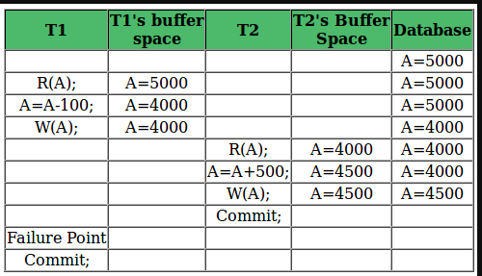

Slide 59

Cascading Rollbacks
Cascading rollback – a single transaction failure leads to a series of transaction rollbacks. Consider the following schedule where none of the transactions has yet committed (so the schedule is recoverable)
If T₁₀ fails, T₁₁ and T₁₂ must also be rolled back.
Can lead to the undoing of a significant amount of work

Slide 60
Cascadeless Schedules
If schedule is recoverable to recover schedule from the failure of a transaction Ti, we may have to roll back several transaction.
Cascadeless schedules — cascading rollbacks cannot occur; for each pair of transactions T_{i} and T_{j} such that T_{j} reads a data item previously written by T_{i}, the commit operation of T_{i} appears before the read operation of T_{j}.
Every cascadeless schedule is also recoverable
It is desirable to restrict the schedules to those that are cascadeless.
Every Cascadeless schedule is also recoverable schedule.

Slide 61
Transaction Definition in SQL
Data manipulation language must include a construct for specifying the set of actions that comprise a transaction.
In SQL, a transaction begins implicitly.
A transaction in SQL ends by:
  Commit work commits current transaction and begins a new one.
  COMMIT TRANSACTION makes all data modifications performed since the start of the transaction a permanent part of the database,
  Rollback work causes current transaction to abort.
  ROLLBACK TRANSACTION without a savepoint_name or transaction_name rolls back to the beginning of the transaction.
  Save point Partially rollback transaction.

Slide 62
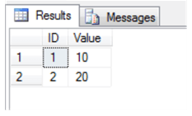
BEGIN TRANSACTION
INSERT INTO TestTable( ID, Value ) VALUES ( 1, '10‘) -- this will create a savepoint
SAVE TRANSACTION FirstInsert
INSERT INTO TestTable( ID, Value ) VALUES ( 2, '20')
-- this will create a savepoint with same name
SAVE TRANSACTION SecondInsert
INSERT INTO TestTable( ID, Value ) VALUES ( 3, '30')
-- this will rollback to the last savepoint named DataInsert
ROLLBACK TRANSACTION secondInsert
COMMIT
O/P

Slide 63


Slide 64
Concurrency Control
Concurrency control is used to control the interaction among concurrent transaction so that it deserves Isolation Property.
One way to ensure serializability is data item should be accessed in mutual exclusive manner i.e one transaction is accessing data item another transaction should not modify data item.

Slide 65

A lock is a mechanism to control concurrent access to a data item
Data items can be locked in two modes :
1. exclusive (X) mode. Data item can be both read as well as
written. X-lock is requested using lock-X instruction.
2. shared (S) mode. Data item can only be read. S-lock is
requested using lock-S instruction.
Lock requests are made to concurrency-control manager. Transaction can proceed only after request is granted.

Slide 66


Lock-compatibility matrix
A transaction may be granted a lock on an item if the requested lock is compatible with locks already held on the item by other transactions
Any number of transactions can hold shared locks on an item,
  but if any transaction holds an exclusive on the item no other transaction may hold any lock on the item.
If a lock cannot be granted, the requesting transaction is made to wait till all incompatible locks held by other transactions have been released. The lock is then granted.

Slide 67
Example of a transaction performing locking:
T₂: lock-S(A);
read (A);
unlock(A);
lock-S(B);
read (B);
unlock(B);
display(A+B)

Slide 68
Locking as above is not sufficient to guarantee serializability — if A and B get updated in-between the read of A and B, the displayed sum would be wrong.
A locking protocol is a set of rules followed by all transactions while requesting and releasing locks. Locking protocols restrict the set of possible schedules.

Slide 69


Consider the partial schedule
1.Deadlock:
2.Starvation

Slide 70
Neither T₃ nor T₄ can make progress — executing lock-S(B) causes T₄ to wait for T₃ to release its lock on B, while executing lock-X(A) causes T₃ to wait for T₄ to release its lock on A.
Such a situation is called a deadlock.
  To handle a deadlock one of T₃ or T₄ must be rolled back
  and its locks released.

Slide 71
Starvation is also possible if concurrency control manager is badly designed. For example:
  A transaction may be waiting for an X-lock on an item, while a sequence of other transactions request and are granted an S-lock on the same item.
  The same transaction is repeatedly rolled back due to deadlocks.
Concurrency control manager can be designed to prevent starvation.

Slide 72

This is a protocol which ensures conflict-serializable schedules.
Phase 1: Growing Phase
  transaction may obtain locks
  transaction may not release locks
Phase 2: Shrinking Phase
  transaction may release locks
  transaction may not obtain locks
The protocol assures serializability. It can be proved that the transactions can be serialized in the order of their lock points (i.e. the point where a transaction acquired its final lock).

Slide 73
What is LOCK POINT ?
The Point at which the growing phase ends, i.e., when transaction takes the final lock it needs to carry on its work.
Drawbacks:
Two-phase locking does not ensure freedom from deadlocks
Cascading roll-back is possible under two-phase locking.

Slide 74
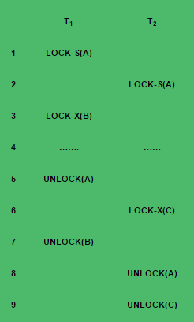
Example:

Slide 75

Two-phase locking does not ensure freedom from deadlocks
Cascading roll-back is possible under two-phase locking.
To avoid this, follow a modified protocol called strict two-phase locking.
Here a transaction must hold all its exclusive locks till it commits/aborts.
Rigorous two-phase locking is even stricter: here all locks are held till commit/abort. In this protocol transactions can be serialized in the order in which they commit.
Conservative 2PL: All locks should be acquired before transaction.

Slide 76
T1: T2 T3
Lock-S(A) Lock-S(A) Lock-s(A)
R(A) R(A) R(A)
Lock-X(B) Lock-X(B) Unlock(A)
R(A) Unlock-(A) Lock-X(B)
R(B) R(B) R(B)
B=A+B W(B) W(B)
Unlock(A) commit Unlock(B)
W(B) Unlock(B) commit
Unlock(B)
commit

Slide 77

Two-phase locking with lock conversions:
– First Phase:
  can acquire a lock-S on item
  can acquire a lock-X on item
  can convert a lock-S to a lock-X (upgrade)
– Second Phase:
  can release a lock-S
  can release a lock-X
  can convert a lock-X to a lock-S (downgrade)
This protocol assures serializability. But still relies on the programmer to insert the various locking instructions.

Slide 78

A transaction T_{i} issues the standard read/write instruction, without explicit locking calls.
The operation read(D) is processed as:
if T_{i} has a lock on D
then
read(D)
else begin
if necessary wait until no other
transaction has a lock-X on D
grant T_{i} a lock-S on D;
read(D)
end

Slide 79
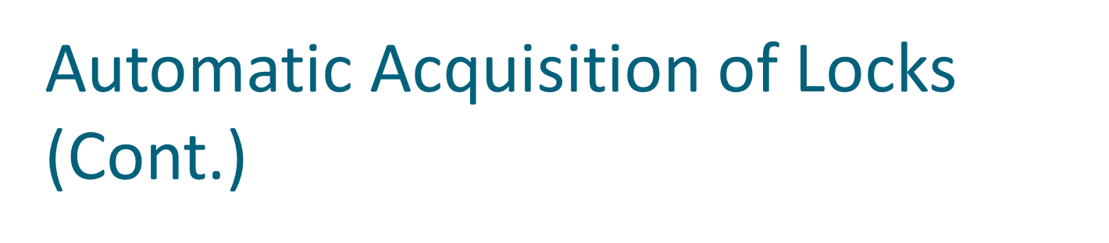
write(D) is processed as:
if T_{i} has a lock-X on D
then
write(D)
else begin
if necessary wait until no other trans. has any lock on D,
if T_{i} has a lock-S on D
then
upgrade lock on D to lock-X
else
grant T_{i} a lock-X on D
write(D)
end;
All locks are released after commit or abort

Slide 80
Implementation of Locking
A lock manager can be implemented as a separate process to which transactions send lock and unlock requests
The lock manager replies to a lock request by sending a lock grant messages (or a message asking the transaction to roll back, in case of a deadlock)
The requesting transaction waits until its request is answered
The lock manager maintains a data-structure called a lock table to record granted locks and pending requests
The lock table is usually implemented as an in-memory hash table indexed on the name of the data item being locked

Slide 81

Lock Table
Black rectangles indicate granted locks, white ones indicate waiting requests
Lock table also records the type of lock granted or requested
New request is added to the end of the queue of requests for the data item, and granted if it is compatible with all earlier locks
Unlock requests result in the request being deleted, and later requests are checked to see if they can now be granted
If transaction aborts, all waiting or granted requests of the transaction are deleted
  lock manager may keep a list of locks held by each transaction, to implement this efficiently
Granted
Waiting

Slide 82
Timestamp-Based Protocols
The most commonly used concurrency protocol is the timestamp based protocol.
This protocol uses either system time or logical counter as a timestamp.
Lock-based protocols manage the order between the conflicting pairs among transactions at the time of execution, whereas timestamp-based protocols start working as soon as a transaction is created.
Every transaction has a timestamp associated with it, and the ordering is determined by the age of the transaction.
A transaction created at 0002 clock time would be older than all other transactions that come after it.

Slide 83
For example, any transaction 'y' entering the system at 0004 is two seconds younger and the priority would be given to the older one.
In addition, every data item is given the latest read and write-timestamp.
This lets the system know when the last ‘read and write’ operation was performed on the data item.

Slide 84
Timestamp Ordering Protocol
The timestamp-ordering protocol ensures serializability among transactions in their conflicting read and write operations.
This is the responsibility of the protocol system that the conflicting pair of tasks should be executed according to the timestamp values of the transactions.
The timestamp of transaction Ti is denoted as TS(Ti).
Read time-stamp of data-item X is denoted by R-timestamp(X).
Write time-stamp of data-item X is denoted by W-timestamp(X).

Slide 85

Each transaction is issued a timestamp when it enters the system. If an old transaction T_{i} has time-stamp TS(T_{i}), a new transaction T_{j} is assigned time-stamp TS(T_{j}) such that TS(T_{i}) <TS(T_{j}).
The protocol manages concurrent execution such that the time-stamps determine the serializability order.
In order to assure such behavior, the protocol maintains for each data Q two timestamp values:
  W-timestamp(Q) is the largest time-stamp of any transaction that executed write(Q) successfully.
  R-timestamp(Q) is the largest time-stamp of any transaction that executed read(Q) successfully.

Slide 86

The timestamp ordering protocol ensures that any conflicting read and write operations are executed in timestamp order.
Suppose a transaction T_{i} issues a read(Q)
  If TS(T_{i}) ≤ W-timestamp(Q), then T_{i} needs to read a value of Q that was already overwritten.
    Hence, the read operation is rejected, and T_{i} is rolled back.
  If TS(T_{i})≥ W-timestamp(Q), then the read operation is executed, and R-timestamp(Q) is set to max(R-timestamp(Q), TS(T_{i})).

Slide 87

Suppose that transaction T_{i} issues write(Q).
  If TS(T_{i}) < R-timestamp(Q), then the value of Q that T_{i} is producing was needed previously, and the system assumed that that value would never be produced.
    Hence, the write operation is rejected, and T_{i} is rolled back.
  If TS(T_{i}) < W-timestamp(Q), then T_{i} is attempting to write an obsolete value of Q.
    Hence, this write operation is rejected, and T_{i} is rolled back.
  Otherwise, the write operation is executed, and W-timestamp(Q) is set to TS(T_{i}).

Slide 88
Schedule 1:
T14 T15
Read(B)
        read(B)
        B=B-50
        write(B)
        Read(A)
        read(A)
        Display(A+B)
        A=A+50
        write(A)
        display(A+B)
        TS(T14)<TS(T15) Serial order T14 ->T15 Conflict Serializable to T14 follows with T15

Slide 89
Schedule 2:
T14 T15
Read(A)
        read(B)
        B=B-50
        write(B)
        Read(B)
        read(A)
        Display(A+B)
        A=A+50
        write(A)
        display(A+B)
        TS(T14)<TS(T15) Not Conflict Serializable to T14 follows with T15

Slide 90
Timestamp Ordering protocol ensures conflict serializability.
The protocol ensures freedom from the deadlock, since no transaction ever waits.
However, there is a possibility of Starvation of long transaction if a sequence of conflicting start transactions caused repeated restarting of the long transaction.
Protocol generates the schedules that are not recoverable.

Slide 91
The timestamp-ordering protocol guarantees serializability since all the arcs in the precedence graph are of the form:
Thus, there will be no cycles in the precedence graph
Timestamp protocol ensures freedom from deadlock as no transaction ever waits.
But the schedule may not be cascade-free, and may not even be recoverable.
transaction
with smaller
timestamp
transaction
with larger
timestamp

Slide 92
Thomas Write Rule (modification to Timestamp ordering protocol)
Ensures greater potential concurrency
Suppose that Transaction T_{i} issues write(Q)
If TS(T_{i}) < R- timestamp(Q), then the value of Q that T_{i}­ is producing was needed previously and the system assumed that, that value would never be produced, Hence the system rejects the write operation and rolls T_{i ­}back.
If TS(T_{i})<W-timestamp(Q), then T_{i} is attempting to write an obsolete value of Q, Hence this write operation is ignored
Otherwise, the system executes the write operation and sets W-timestamp to TS(T_{i}).

Slide 93

Modified version of the timestamp-ordering protocol in which obsolete write operations may be ignored under certain circumstances.
When T_{i} attempts to write data item Q, if TS(T_{i}) < W-timestamp(Q), then T_{i} is attempting to write an obsolete value of {Q}.
  Rather than rolling back T_{i} as the timestamp ordering protocol would have done, this {write} operation can be ignored.
Otherwise this protocol is the same as the timestamp ordering protocol.

Slide 94
Deadlock
A system is in deadlock state if there exists a of transactions such that every transaction in the set is waiting for another transaction in the set.
There exists a set of transactions such that T0 is waiting for data item that T1 holds,T1 is waiting for data item that transaction T2 holds and transaction T2 waiting for transaction that T0 holds.

Slide 95

Consider the following two transactions:
T₁: write (X) T₂: write(Y)
write(Y) write(X)
Schedule with deadlock
T₁
T₂
lock-X on X
write (X)
lock-X on Y
write (X)
wait for lock-X on X
wait for lock-X on Y

Slide 96
System is deadlocked if there is a set of transactions such that every transaction in the set is waiting for another transaction in the set.
Deadlock prevention protocols ensure that the system will never enter into a deadlock state. Some prevention strategies :
  Require that each transaction locks all its data items before it begins execution (pre declaration).
  Impose partial ordering of all data items and require that a transaction can lock data items only in the order specified by the partial order (graph-based protocol).

Slide 97

Following schemes use transaction timestamps for the sake of deadlock prevention alone.
wait-die scheme — non-preemptive
  older transaction may wait for younger one to release data item. Younger transactions never wait for older ones; they are rolled back instead.
  a transaction may die several times before acquiring needed data item
wound-wait scheme — preemptive
  older transaction wounds (forces rollback) of younger transaction instead of waiting for it. Younger transactions may wait for older ones.
  may be fewer rollbacks than wait-die scheme.

Slide 98

Both in wait-die and in wound-wait schemes, a rolled back transactions is restarted with its original timestamp. Older transactions thus have precedence over newer ones, and starvation is hence avoided.
Timeout-Based Schemes :
  a transaction waits for a lock only for a specified amount of time. After that, the wait times out and the transaction is rolled back.
  thus deadlocks are not possible
  simple to implement; but starvation is possible. Also difficult to determine good value of the timeout interval.

Slide 99

Deadlocks can be described as a wait-for graph, which consists of a pair G = (V,E),
  V is a set of vertices (all the transactions in the system)
  E is a set of edges; each element is an ordered pair T_{i} →T_{j}.
If T_{i} → T_{j} is in E, then there is a directed edge from T_{i} to T_{j}, implying that T_{i} is waiting for T_{j} to release a data item.

Slide 100
When T_{i} requests a data item currently being held by T_{j}, then the edge T_{i} T_{j} is inserted in the wait-for graph.
This edge is removed only when T_{j} is no longer holding a data item needed by T_{i}.
The system is in a deadlock state if and only if the wait-for graph has a cycle.
Must invoke a deadlock-detection algorithm periodically to look for cycles.

Slide 101



Wait-for graph without a cycle
Wait-for graph with a cycle

Slide 102

When deadlock is detected :
  Some transaction will have to rolled back (made a victim) to break deadlock. Select that transaction as victim that will incur minimum cost.
  Rollback -- determine how far to roll back transaction
    Total rollback: Abort the transaction and then restart it.
    More effective to roll back transaction only as far as necessary to break deadlock.
  Starvation happens if same transaction is always chosen as victim. Include the number of rollbacks in the cost factor to avoid starvation

Slide 103


Slide 104

Transaction failure :
  Logical errors: transaction cannot complete due to some internal error condition
  System errors: the database system must terminate an active transaction due to an error condition (e.g., deadlock)
System crash: a power failure or other hardware or software failure causes the system to crash.
  Fail-stop assumption: non-volatile storage contents are assumed to not be corrupted by system crash
    Database systems have numerous integrity checks to prevent corruption of disk data

Slide 105
Disk failure: a head crash or similar disk failure destroys all or part of disk storage
  Destruction is assumed to be detectable: disk drives use checksums to detect failures

Slide 106
Recovery Algorithms
Recovery algorithms are techniques to ensure database consistency and transaction atomicity and durability despite failures.
Recovery algorithms have two parts
  Actions taken during normal transaction processing to ensure enough information exists to recover from failures
  Actions taken after a failure to recover the database contents to a state that ensures atomicity, consistency and durability

Slide 107

Volatile storage:
  does not survive system crashes
  examples: main memory, cache memory
Nonvolatile storage:
  survives system crashes
  examples: disk, tape, flash memory,
  non-volatile (battery backed up) RAM
Stable storage:
  a mythical form of storage that survives all failures
  approximated by maintaining multiple copies on distinct nonvolatile media

Slide 108

Maintain multiple copies of each block on separate disks
  copies can be at remote sites to protect against disasters such as fire or flooding.
Failure during data transfer can still result in inconsistent copies: Block transfer can result in
  Successful completion
  Partial failure: destination block has incorrect information
  Total failure: destination block was never updated

Slide 109
Protecting storage media from failure during data transfer (one solution):
  Execute output operation as follows (assuming two copies of each block):
    Write the information onto the first physical block.
    When the first write successfully completes, write the same information onto the second physical block.
    The output is completed only after the second write successfully completes.

Slide 110
Protecting storage media from failure during data transfer (cont.):
Copies of a block may differ due to failure during output operation. To recover from failure:
  First find inconsistent blocks:
    Expensive solution: Compare the two copies of every disk block.
    Better solution:
      Record in-progress disk writes on non-volatile storage (Non-volatile RAM or special area of disk).
      Use this information during recovery to find blocks that may be inconsistent, and only compare copies of these.
      Used in hardware RAID systems.

Slide 111
If either copy of an inconsistent block is detected to have an error (bad checksum), overwrite it by the other copy.
If both have no error, but are different, overwrite the second block by the first block

Slide 112

Physical blocks are those blocks residing on the disk.
Buffer blocks are the blocks residing temporarily in main memory.
Block movements between disk and main memory are initiated through the following two operations:
  input(B) transfers the physical block B to main memory.
  output(B) transfers the buffer block B to the disk, and replaces the appropriate physical block there.
Each transaction T_{i} has its private work-area in which local copies of all data items accessed and updated by it are kept.
  T_{i}'s local copy of a data item X is called x_{i}.

Slide 113
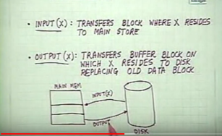
We assume, for simplicity, that each data item fits in, and is stored inside, a single block.

Slide 114


Transaction transfers data items between system buffer blocks and its private work-area using the following operations :
  read(X) assigns the value of data item X to the local variable x_{i}.
  write(X) assigns the value of local variable x_{i} to data item {X} in the buffer block.
  both these commands may necessitate the issue of an input(B_{X}) instruction before the assignment, if the block B_{X} in which X resides is not already in memory.

Slide 115
Transactions
  Perform read(X) while accessing X for the first time;
  All subsequent accesses are to the local copy.
  After last access, transaction executes write(X).
output(B_{X}) need not immediately follow write(X). System can perform the output operation when it deems fit.

Slide 116

buffer
Buffer Block A
input(A)
X
A
Buffer Block B
Y
B
output(B)
read(X)
write(Y)
x₂
x₁
y₁
work area
of T₁
work area
of T₂
memory
disk

Slide 117

Modifying the database without ensuring that the transaction will commit may leave the database in an inconsistent state.
Consider transaction T_{i} that transfers $50 from account A to account B; goal is either to perform all database modifications made by T_{i} or none at all.
Several output operations may be required for T_{i} (to output A and B). A failure may occur after one of these modifications have been made but before all of them are made.

Slide 118
Recovery Algorithms
Recovery algorithms are techniques to ensure database consistency and transaction atomicity and durability despite failures.
Recovery algorithms have two parts
  Actions taken during normal transaction processing to ensure enough information exists to recover from failures
  Actions taken after a failure to recover the database contents to a state that ensures atomicity, consistency and durability

Slide 119
Recovery and Atomicity (Cont.)
To ensure atomicity despite failures, we first output information describing the modifications to stable storage without modifying the database itself.
We study two approaches:
  log-based recovery, and
  shadow-paging
We assume (initially) that transactions run serially, that is, one after the other.

Slide 120

Log is a sequence of modifications done to the database.
A log is kept on stable storage.
  The log is a sequence of log records that is stored on stable storage, and maintains a record of update activities on the database.
When transaction T_{i} starts, it registers itself by writing a
<T_{i} start>log record
Before T_{i} executes write(X), a log record <T_{i}, X, V₁, V₂> is written, where V₁ is the value of X before the write, and V₂ is the value to be written to X.
  Log record notes that T_{i} has performed a write on data item X_{j} X_{j} had value V₁ before the write, and will have value V₂ after the write.

Slide 121
When T_{i} finishes it last statement, the log record <T_{i} commit> is written.
Various Types of Log Records:
<Ti start>
<Ti,X,V1,V2>:Ti has performed write operation on data item X.V1:-Old value V2: New value.
<Ti commit>: Ti is committed
<Ti abort>: Transaction Ti is aborted

Slide 122
We assume for now that log records are written directly to stable storage (that is, they are not buffered)
Two approaches using logs
  Deferred database modification
  Immediate database modification

Slide 123

The deferred database modification scheme records all modifications to the log, but defers all the writes to after partial commit.
Assume that transactions execute serially
Transaction starts by writing <T_{i} start> record to log.
A write(X) operation results in a log record <T_{i}, X, V> being written, where V is the new value for X
  Note: old value is not needed for this scheme

Slide 124
The write is not performed on X at this time, but is deferred.
When T_{i} partially commits, <T_{i} commit> is written to the log
Finally, the log records are read and used to actually execute the previously deferred writes.

Slide 125
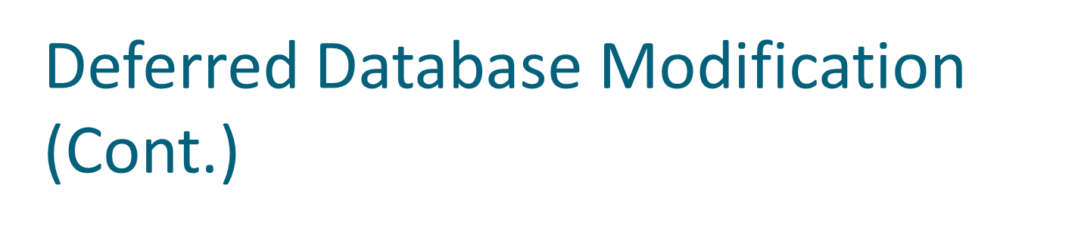
During recovery after a crash, a transaction needs to be redone if and only if both <T_{i} start> and<T_{i} commit> are there in the log.
Redoing a transaction T_{i} ( redoT_{i}) sets the value of all data items updated by the transaction to the new values.
Crashes can occur while
  the transaction is executing the original updates, or while recovery action is being taken
  Recovery Technique: redo Ti

Slide 126
A=1000 B=2000 c=700
example transactions T₀ and T₁ (T₀ executes before T₁):
T₀: read (A) T₁ : read (C)
A: - A - 50 C:-C- 100
Write (A) write (C)
read (B)
B:- B + 50
write (B)

Slide 127

Log Write Output
<T₀ start>
<T₀, A, 950>
T_{o}, B, 2050
A=950
B=2050
<T₀ commit>
B_{A}
B_{B}
<T₁ start>
<T₁, C, 600>
C = 600
<T₁ commit>
B_{c}
Note: B_{X} denotes block containing X.

Slide 128
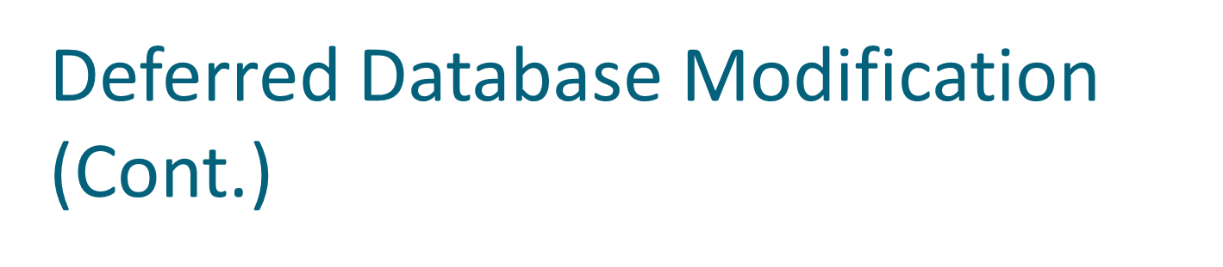

Below we show the log as it appears at three instances of time.
If log on stable storage at time of crash is as in case:
(a) No redo actions need to be taken
(b) redo(T₀) must be performed since <T₀ commit> is present
(c) redo(T₀) must be performed followed by redo(T₁) since
<T₀ commit> and <T_{i} commit> are present

Slide 129

The immediate database modification scheme allows database updates of an uncommitted transaction to be made as the writes are issued
  since undoing may be needed, update logs must have both old value and new value
Update log record must be written before database item is written
  We assume that the log record is output directly to stable storage
  Can be extended to postpone log record output, so long as prior to execution of an output(B) operation for a data block B, all log records corresponding to items B must be flushed to stable storage

Slide 130
The Immediate database modification scheme records all modifications to the log, but defers all the writes to after partial commit.
Assume that transactions execute serially
Transaction starts by writing <T_{i} start> record to log.
A write(X) operation results in a log record <T_{i}, X, V1,V2> being written, where V is the new value for X
  Note: old value as well as new value is needed for this scheme

Slide 131
Output of updated blocks can take place at any time before or after transaction commit
Order in which blocks are output can be different from the order in which they are written.

Slide 132

Log Write Output
<T₀ start>
<T₀, A, 1000, 950>
A = 950
<T_{o}, B, 2000, 2050>
B = 2050
<T₀ commit>
B_{A} B_{B}
<T₁ start>
<T₁, C, 700, 600>
C = 600
<T₁ commit>
Bc
Note: B_{X} denotes block containing X.

Slide 133
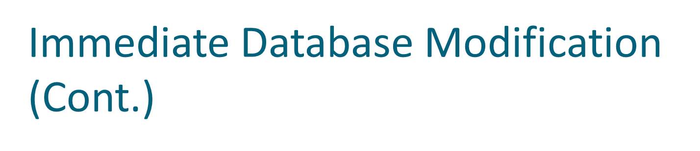
Recovery procedure has two operations instead of one:
  undo(T_{i}) restores the value of all data items updated by T_{i} to their old values, going backwards from the last log record for T_{i}
  redo(T_{i}) sets the value of all data items updated by T_{i} to the new values, going forward from the first log record for T_{i}

Slide 134
When recovering after failure:
  Transaction T_{i} needs to be undone if the log contains the record
  <T_{i} start>, but does not contain the record <T_{i} commit>.
  Transaction T_{i} needs to be redone if the log contains both the record <T_{i} start> and the record <T_{i} commit>.
Undo operations are performed first, then redo operations.

Slide 135


Below we show the log as it appears at three instances of time.
Recovery actions in each case above are:
(a) undo (T₀): B is restored to 2000 and A to 1000.
(b) undo (T₁) and redo (T₀): C is restored to 700, and then A and B are
set to 950 and 2050 respectively.
(c) redo (T₀) and redo (T₁): A and B are set to 950 and 2050
respectively. Then C is set to 600

Slide 136

When System failure occurs log records will be used to determine those transactions that need to be redone and those that need to be undone.
Need to search entire log to determine this info.
Drawback:
Time consuming
Unnecessary redo operation
To reduce this overhead checkpoint is used.

Slide 137

Problems in recovery procedure as discussed earlier :
  searching the entire log is time-consuming
  we might unnecessarily redo transactions which have already
  output their updates to the database.
Streamline recovery procedure by periodically performing checkpointing
  Output all log records currently residing in main memory onto stable storage.
  Output all modified buffer blocks to the disk.
  Write a log record < checkpoint> onto stable storage.

Slide 138

During recovery we need to consider only the most recent transaction T_{i} that started before the checkpoint, and transactions that started after T_{i}.
  Scan backwards from end of log to find the most recent <checkpoint> record
  Continue scanning backwards till a record <T_{i} start> is found.
  Need only consider the part of log following above start record.
  Earlier part of log can be ignored during recovery, and can be erased whenever desired.

Slide 139
  For all transactions (starting from T_{i} or later) with no <T_{i} commit>, execute undo(T_{i}). (Done only in case of immediate modification.)
  Scanning forward in the log, for all transactions starting from T_{i} or later with a <T_{i} commit>, execute redo(T_{i}).

Slide 140

T_{c}
T_{f}
T₁ can be ignored (updates already output to disk due to checkpoint)
T₂ and T₃ redone.
T₄ undone
T₁
T₂
T₃
T₄
checkpoint
system failure

Slide 141
Shadow Paging
Shadow Paging
■ Shadow paging is an alternative to log-based recovery.
This scheme is useful if transactions execute serially .
■ Idea: maintain two page tables during the lifetime of a transaction – the current page table, and the shadow page table
■ Store the shadow page table in nonvolatile storage, such that state of the database prior to transaction execution may be recovered.
Shadow page table is never modified during execution ■ To start with, both the page tables are identical.

Slide 142
Only current page table is used for data item accesses during execution of the transaction.
The shadow page table never changed over the duration of the transaction.
Current page table will be changed when write(X) operation is performed.

Slide 143
If T_{j} performs Write(X) operation and if X resides in i_{th} page:
If ith page is not in main memory then system issues input(X).
Current page table will be modified.
It assigns x_{j} to X in the buffer page.

Slide 144
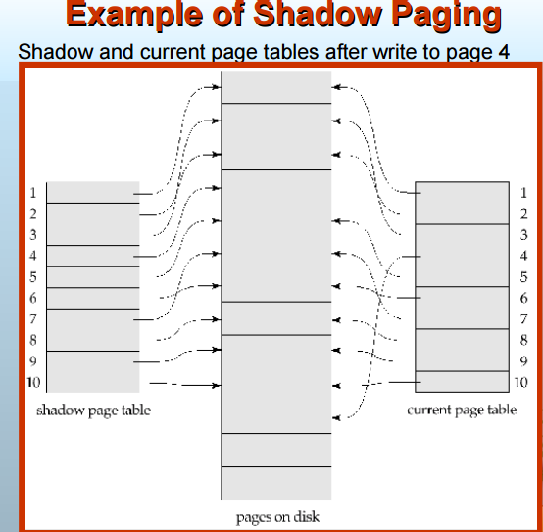

Slide 145
■ To commit a transaction :
1. Flush all modified pages in main memory to disk
2. Output current page table to disk
3. Make the current page table the new shadow page table.

Slide 146
Advantages of shadow-paging over log-based schemes
no overhead of writing log records
recovery is trivial
■ Disadvantages :
Copying the entire page table is very expensive
Can be reduced by using a page table structured like a B+ -tree.
No need to copy entire tree, only need to copy paths in the tree that lead to updated leaf nodes
Commit overhead is high even with above extension
Need to flush every updated page, and page table

Slide 147
Data gets fragmented (related pages get separated on disk)
After every transaction completion, the database pages containing old versions of modified data need to be garbage collected.
Hard to extend algorithm to allow transactions to run concurrently
Easier to extend log based schemes

